Slide 1
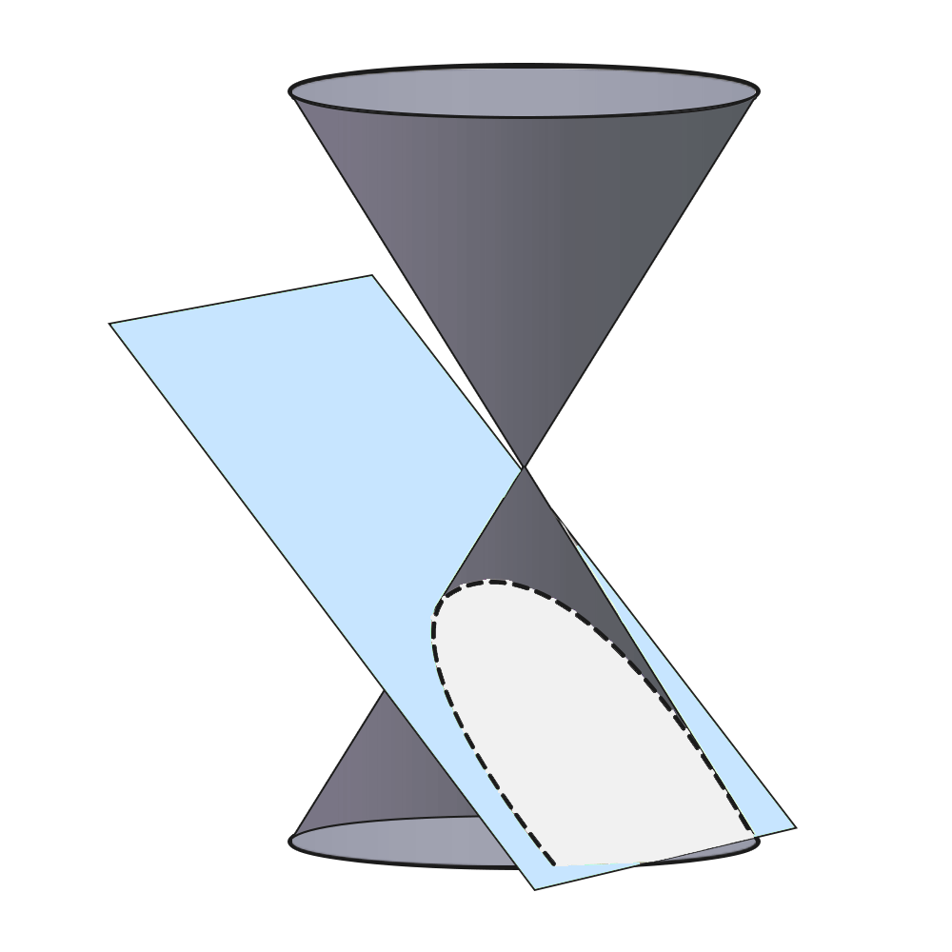
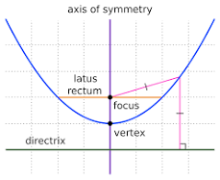
PARABOLA
Parabola is defined as the set of all points that are equidistant from a fixed point (called the focus) and a fixed straight line (called the directrix). The focus and directrix are two essential elements that determine the shape and position of a parabola
A parabola is formed by the intersection of a plane with a cone when the cone intersects parallel to the slant height of the cone.

Slide 2
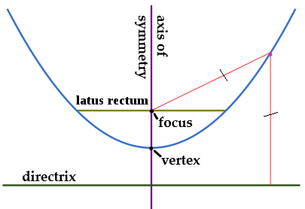
Important terms of of Parabola
Axis of Symmetry: The line that is perpendicular to the directrix and passes through the focus is called the axis of symmetry. The parabola is symmetrical about its axis of symmetry.
Vertex: The point where the parabola intersects its axis of symmetry is called the vertex. The vertex is the point where the parabola changes direction from opening upwards to opening downwards (or vice versa).
Focal Length: The distance between the vertex and the focus is called the focal length. All parabolas with the same focal length are similar.
Directrix: The fixed line from which any point on the parabola is the same distance as the focus.
5. Focal Chord: The focal chord of a parabola is the chord passing through the focus of the parabola. The focal chord cuts the parabola at two distinct points.
6. Eccentricity: (e = 1). It is the ratio of the distance of a point from the focus, to the distance of the point from the directrix. The eccentricity of a parabola is equal to 1.

Slide 3
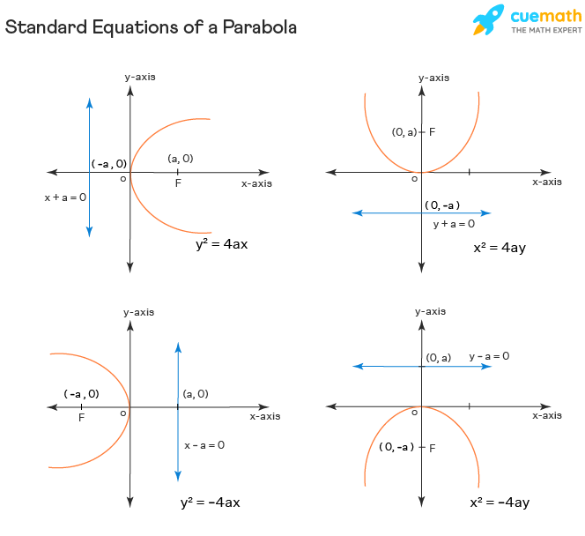
There are four standard equations of a parabola.
y² = 4ax
y² = -4ax
x² = 4ay
x² = -4ay
The below image presents the four standard equations and forms of the parabola.

Slide 4
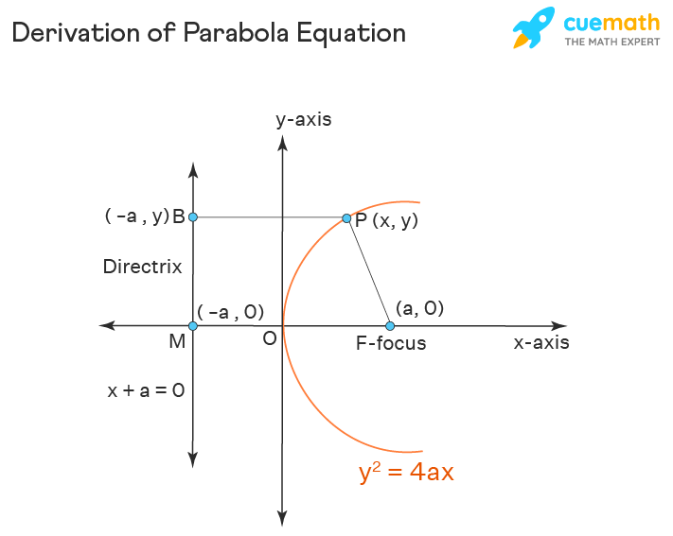
Derivation of Parabola Equation
Let us consider a point P with coordinates (x, y) on the parabola. As per the definition of a parabola, the distance of this point from the focus F is equal to the distance of this point P from the Directrix. Here we consider a point B on the directrix, and the perpendicular distance PB is taken for calculations.
As per this definition of the eccentricity of the parabola, we have PF = PB (Since e = PF/PB =1)
The coordinates of the focus are F(a,0), and we can use the coordinate distance formula to find its distance from P(x, y):
PF = sqrt((x - a)^2 + (y - 0)^2) = sqrt((x - a)^2 + y^2)
The equation of the directrix is x + a = 0, and we use the perpendicular distance formula to find PB:
PB = (x + a) / sqrt(1^2 + 0^2) = sqrt((x + a)^2)
We need to derive the equation of the parabola using PF = PB:
sqrt((x - a)^2 + y^2) = sqrt((x + a)^2)
Squaring the equation on both sides:
(x - a)^2 + y^2 = (x + a)^2
x^2 + a^2 - 2ax + y^2 = x^2 + a^2 + 2ax
y^2 - 2ax = 2ax
y^2 = 4ax
Now we have successfully derived the standard equation of a parabola.
Similarly, we can derive the equations of the other types of parabolas as:
(a): y^2 = 4ax,
(b): y^2 = -4ax,
(c): x^2 = 4ay,
(d): x^2 = -4ay.
The above four equations are the Standard Equations of Parabolas.

Slide 5
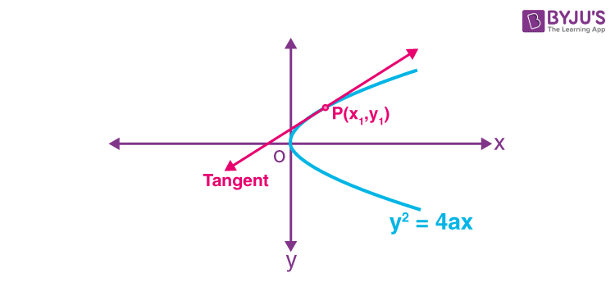
Tangent to a Parabola
A line that touches the parabola exactly at one point is called the tangent to a parabola..
Equation of Tangent to a Parabola
1. Point Form
The equation of tangent to the parabola y² = 4ax at point P(x₁, y₁) is yy₁ = 2a(x + x₁).
Proof: Consider the parabola y² = 4ax….(i)
Let the point (x₁, y₁) lie on it.
So, we can write y₁² = 4ax₁ …(ii)
Differentiate equation (i) with respect to x.
2y (dy/dx) = 4a
=> dy/dx = 4a/2y
= 2a/y (slope)
Let m be the slope of the tangent at point (x₁, y₁), then
(dy/dx) at (x₁, y₁) = m = 2a/y₁
The equation of tangent at (x₁, y₁) is given by
(y – y₁) = m(x – x₁)
=> (y – y₁) = (2a/y₁)(x – x₁)
=> yy₁ – y₁² = 2a(x – x₁)
Substitute (ii) in the above equation
yy₁ – 4ax₁ = 2a(x – x₁)
=> yy₁ = 2ax – 2ax₁ + 4ax₁
=> yy₁ = 2ax + 2ax₁
=> yy₁ = 2a(x + x₁) ….(iii) required equation.

Slide 6
2. Slope form
The equation of the tangent of the parabola y² = 4ax is y = mx + a/m, where c = a/m.
The point of contact is (a/m², 2a/m).
Proof:
Let y² = 4ax be the parabola. Suppose the line y = mx + c is the tangent to the parabola.
The condition that the line y = mx + c is the tangent to the parabola y² = 4ax is c = a/m.
Put c = a/m in y = mx + c.
Here, m is the slope of the tangent.
=> y = mx + a/m, which is the required equation.
b. If the parabola is given by x² = 4ay, then the tangent is given by y = mx – am². The point of contact is (2am, am²)

Slide 7
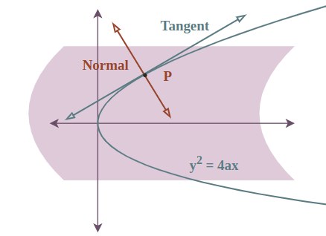
Normal form of parabola
Equation of normal of parabola
To find the equation of the normal to the parabola y^2 = 4ax.
We can use the fact that the normal at any point (x1, y1) on the parabola is given by the equation: y - y1 = -1/m(x - x1)
Where m is the slope of the tangent at the point (x1, y1).
The slope of the tangent at any point (x1, y1) on the parabola y^2 = 4ax is given by (-2a/y1)
. So, the equation of the normal to the parabola y^2 = 4ax at the point (x1, y1) is:
(y - y1) = -(y1/2a)(x - x1)
This is the equation of the normal to the parabola y^2 = 4ax at the point (x1, y1).

Slide 8
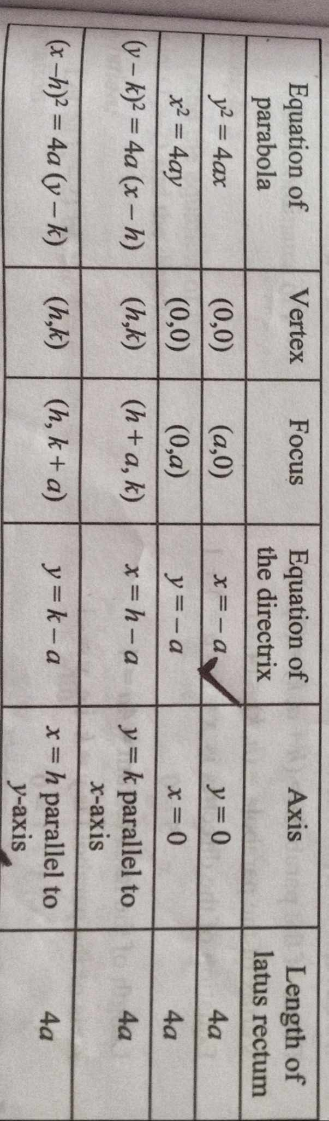
Important Results of Parabola

Slide 9
Application of parabola in real life
Satellite Dish Design:
Explanation: Satellite dishes are often designed using parabolic shapes. The parabolic shape allows the dish to focus incoming signals to a single point, where the receiver is located, maximizing the efficiency of signal capture.
Advantage: The parabolic shape ensures that signals from different directions are reflected towards the receiver, enhancing the quality and strength of the received signals.
Headlight Design in Automobiles:
Explanation: The reflectors in headlights of automobiles are often designed using parabolic shapes. The parabolic reflector focuses light from the bulb into a beam that travels forward, improving visibility for the driver.
Advantage: By utilizing parabolic reflectors, headlights can efficiently distribute light in a controlled manner, enhancing safety and visibility for drivers at night or in low-light
Radio Telescopes:
Explanation: Radio telescopes often have parabolic reflectors to collect and focus radio waves from celestial objects. The shape of the parabola helps in accurately reflecting the incoming waves to the receiver, enabling astronomers to study distant objects in space.
Advantage: The precise focusing capability of parabolic reflectors allows radio telescopes to capture weak signals from space, aiding in the exploration and understanding of the universe.
Bridge Design:
Explanation: The design of suspension bridges often incorporates parabolic shapes in the cables and support structures. The parabolic shape helps distribute the load evenly, ensuring structural stability and minimizing stress concentrations.
Advantage: By utilizing parabolic shapes, suspension bridges can withstand heavy loads and resist deformation caused by forces such as wind and traffic, providing safe passage for vehicles and pedestrians over long spans.
Referenceshttps://byjus.com/jee/parabola/
https://www.cuemath.com/geometry/parabola/
https://www.geeksforgeeks.org/what-is-parabola/

